Slide 1


Maxwell Kilman
October 15, 2024

Slide 2

Outline
Executive Summary
Introduction
Methodology
Results
Conclusion
Appendix

Slide 3
Executive Summary
Methodology:
SpaceX REST API: collecting raw data
EDA: wrangling
Visualizing using bar charts, scatter plots, line charts, graphs
Analyzing with SQL to obtain relevant metrics
Mapping sites of launches with Folium
Creating a Dashboard using Plotly
Predictive Analysis (classification models)
Results:
EDA: Positive correlation between year and launch success %
Screenshots: Interactive maps/dashboard
Predictive Analysis: All models successful

Slide 4
Introduction
Project background and context
Problems you want to find answers

Slide 5

Section 1

Slide 6
Methodology
Executive Summary
Data collection methodology:
Describe how data was collected
Perform data wrangling
Describe how data was processed
Perform exploratory data analysis (EDA) using visualization and SQL
Perform interactive visual analytics using Folium and Plotly Dash
Perform predictive analysis using classification models
How to build, tune, evaluate classification models

Slide 7
Data Collection
Describe how data sets were collected.
You need to present your data collection process use key phrases and flowcharts

Slide 8
Data Collection – SpaceX API
Present your data collection with SpaceX REST calls using key phrases and flowcharts
Add the GitHub URL of the completed SpaceX API calls notebook (must include completed code cell and outcome cell), as an external reference and peer-review purpose
Place your flowchart of SpaceX API calls here

Slide 9
Data Collection - Scraping
Present your web scraping process using key phrases and flowcharts
Add the GitHub URL of the completed web scraping notebook, as an external reference and peer-review purpose
Place your flowchart of web scraping here

Slide 10
Data Wrangling
Describe how data were processed
You need to present your data wrangling process using key phrases and flowcharts
Add the GitHub URL of your completed data wrangling related notebooks, as an external reference and peer-review purpose

Slide 11
EDA with Data Visualization
Scatter Plot: Flight Number vs. Launch Site:
Visualizes the distribution of launches across different sites over time.
Scatter Plot: Payload vs. Launch Site:
Shows the relationship between payload mass and launch sites.
Bar Chart: Success Rate by Orbit Type:
Displays the success rate of missions based on orbit type.
Scatter Plot: Flight Number vs. Orbit Type:
Tracks the types of orbits targeted over the progression of flights.
Scatter Plot: Payload vs. Orbit Type:
Visualizes payload mass distribution across different orbit types.
Line Chart: Yearly Average Success Rate:
Tracks changes in the yearly average success rate of launches.

Slide 12
EDA with SQL
Drop Table
Create New Table
List Launch Sites
Filter Sites by Prefix
Total Payload for NASA
Average Payload for Booster F9 v1.1
Boosters with Successful Drone Ship Landings and Payload Between 4000-6000kg
Count of Successful and Failed Missions
Maximum Payload of Booster
Failed 2015 Landings
Rank Landing Outcomes by Frequency
https://github.com/MaxHK24/IBM_Capstone/blob/main/SQL_Notebook_for_Peer_Assignment.ipynb

Slide 13
Build an Interactive Map with Folium
Summarize what map objects such as markers, circles, lines, etc. you created and added to a folium map
Explain why you added those objects
Add the GitHub URL of your completed interactive map with Folium map, as an external reference and peer-review purpose

Slide 14
Build a Dashboard with Plotly Dash
Summarize what plots/graphs and interactions you have added to a dashboard
Explain why you added those plots and interactions
Add the GitHub URL of your completed Plotly Dash lab, as an external reference and peer-review purpose

Slide 15
Predictive Analysis (Classification)
Summarize how you built, evaluated, improved, and found the best performing classification model
You need present your model development process using key phrases and flowchart
Add the GitHub URL of your completed predictive analysis lab, as an external reference and peer-review purpose

Slide 16
Results
Exploratory data analysis results
Interactive analytics demo in screenshots
Predictive analysis results

Slide 17

Section 2

Slide 18
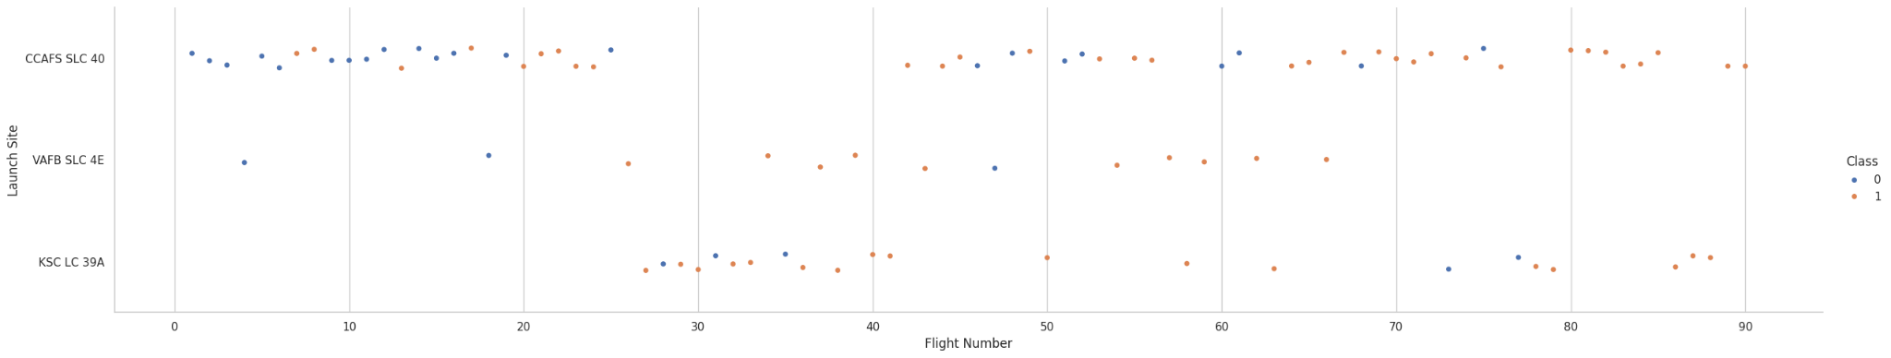
Flight Number vs. Launch Site
Blue dots indicate failed launches. Orange dots indicate successful launches. Overall, CCAFS SLC 40 has about half of all launches, although the other two launch sites have higher success rates. At all three launch sites there is a positive correlation between flight number and success rate.

Slide 19
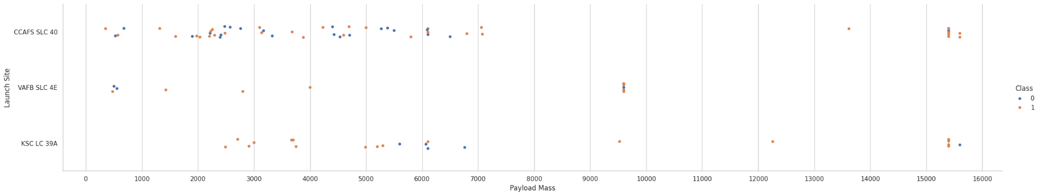
Payload vs. Launch Site
Blue = failed launch. Orange = successful launch. There is a correlation between higher payload mass and launch success; this persists across all launch sites. Launches with payload mass > 7000 kg were overwhelmingly successful. Notably, however, KSC LC 39A succeeded in all launches of payloads < 5500 kg.

Slide 20
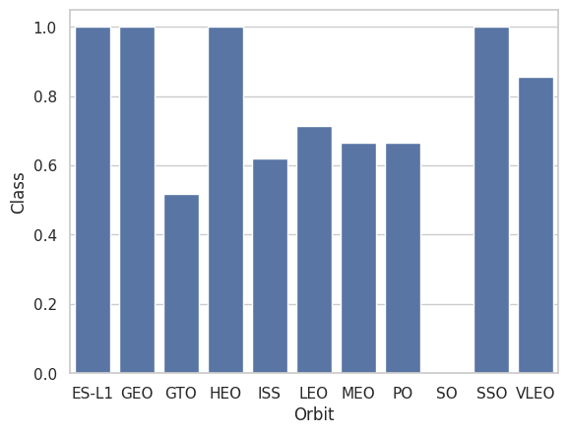
Success Rate vs. Orbit Type
The y-axis represents percentage success rate divided by 100, i.e. 1.0 represents a 100% success rate. The ES-L1, GEO, HEO, and SSO orbits all had a 100% success rate. Conversely, SO had a 0% success rate. All other orbits’ success rates ranged between 50% and 85%.

Slide 21
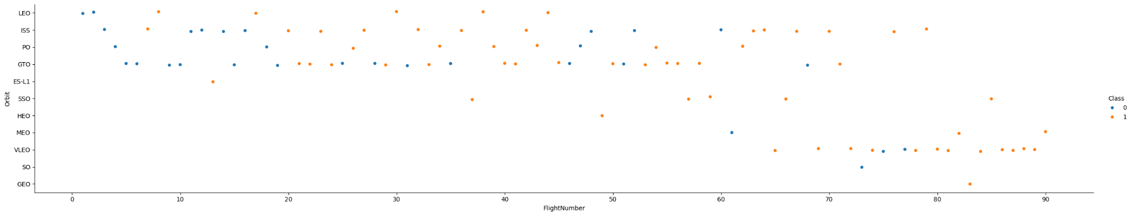
Flight Number vs. Orbit Type
Blue = failed launch. Orange = successful launch. The positive correlation between flight number and success rate persists across all orbit classes, though GTO is a notable outlier in how weak the correlation is. The correlation is strongest for LEO.

Slide 22
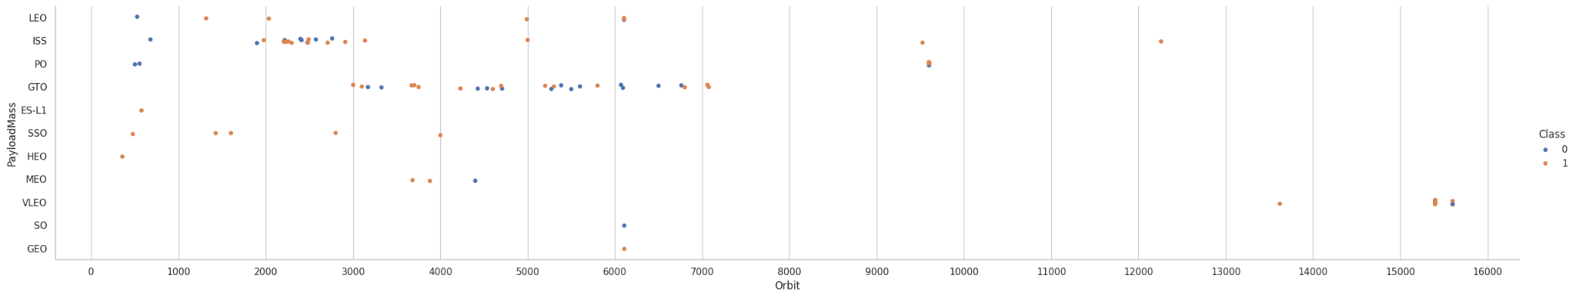
Payload vs. Orbit Type
Most orbits (particularly LEO, ISS, and PO) exhibit a positive correlation between payload mass and success rate. However, this trend is reversed for GTO.

Slide 23
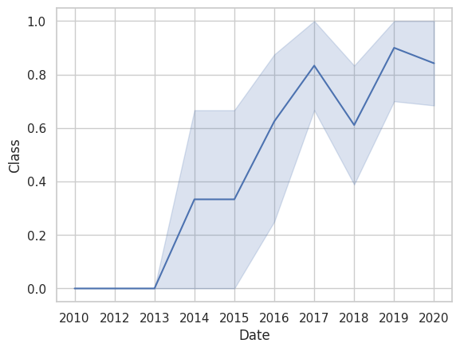
Launch Success Yearly Trend
From 2010, the success rate continually either increased or plateaued on an annual basis until 2018; it has fluctuated considerably since then.

Slide 24
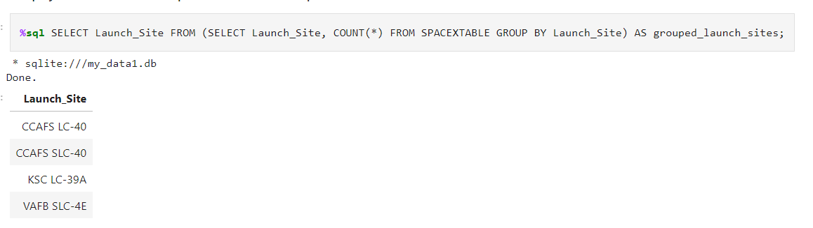
All Launch Site Names
This query counts the number of launches for each unique Launch_Site in the SPACEXTABLE and then from the subquery only selects the Launch_Site columns

Slide 25
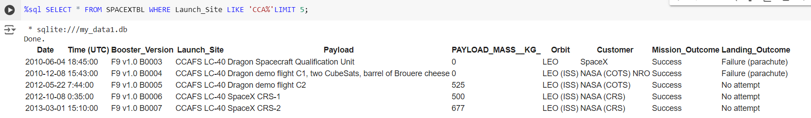
Launch Site Names Begin with 'CCA'
I told the query to iterate the rows of SPACEXTBL and select each successive row for which the Launch_Site column entry started with ‘CCA’ until it had selected a maximum of five rows.

Slide 26
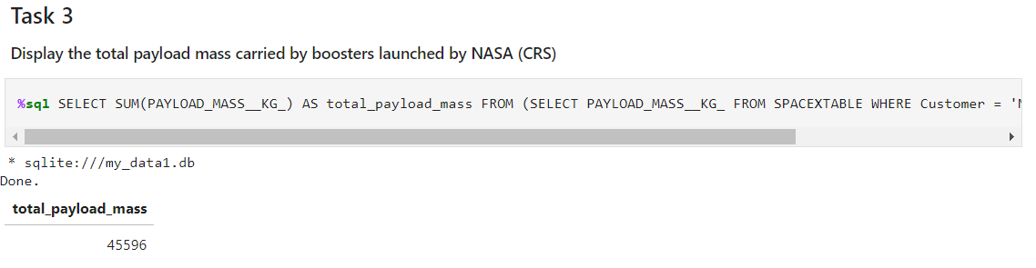
Total Payload Mass
I use a subquery to first select the payload masses for those launches whose customer is “NASA (CRS)” and then summate them in the outer query

Slide 27
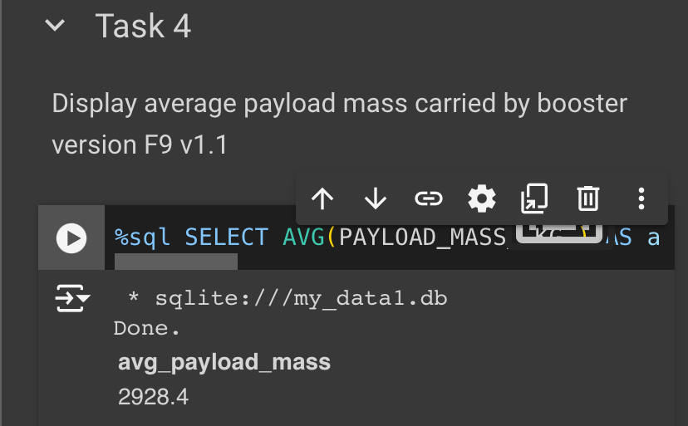
Average Payload Mass by F9 v1.1
Present your query result with a short explanation he
Query: SELECT AVG(PAYLOAD_MASS__KG_) AS avg_payload_mass FROM ( SELECT PAYLOAD_MASS__KG_ FROM SPACEXTABLE WHERE Booster_Version = 'F9 v1.1' );
explanation: inner query selects payload mass from all records where the booster version is Falcon 9 v1.1. Outer query then calculates the average of these payload masses.

Slide 28
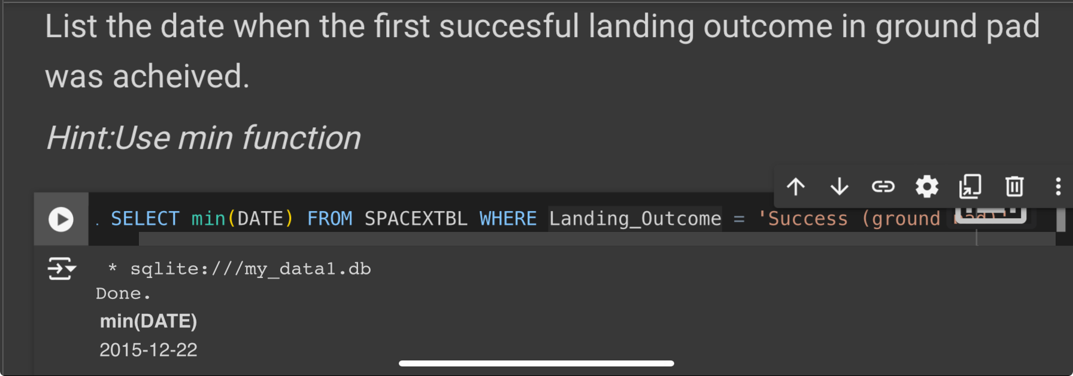
First Successful Ground Landing Date
Present your query result with a short explanation here
Query: SELECT min(DATE) FROM SPACEXTBL WHERE Landing_Outcome = 'Success (ground pad)';
The query concatenates the entries in the spacextbl where the outcome value is listed as a successful ground landing, and then chooses that which has the “minimum” (smallest, e.g. earliest) date value

Slide 29
Successful Drone Ship Landing with Payload between 4000 and 6000
%sql SELECT Booster_Version FROM ( SELECT Booster_Version, PAYLOAD_MASS__KG_, Landing_Outcome FROM SPACEXTABLE WHERE Landing_Outcome = 'Success (drone ship)' ) AS filtered_boosters WHERE PAYLOAD_MASS__KG_ > 4000 AND PAYLOAD_MASS__KG_ < 6000;
This query first filters records from the SPACEXTABLE where the landing outcome was a successful drone ship landing (Landing_Outcome = 'Success (drone ship)'). From this it further selects boosters with a payload mass between 4000 and 6000 kg. The final output lists the booster versions that met both conditions, showing successful drone ship landings within the specified payload range.

Slide 30
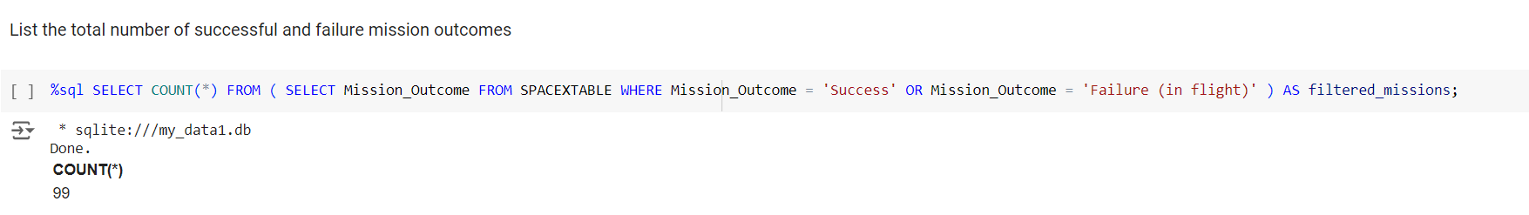
Total Number of Successful and Failure Mission Outcomes
This query first filters the SPACEXTABLE to select only records where the mission outcome was either 'Success' or 'Failure (in flight)'. The outer query then counts the total number of these filtered records, providing the total count of missions that either succeeded or failed in flight.

Slide 31
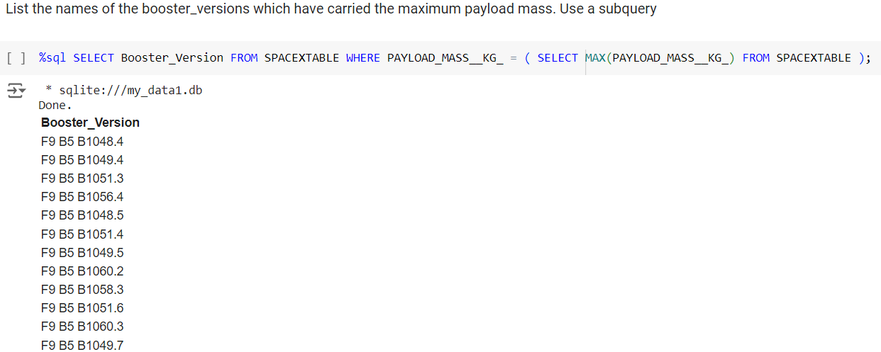
Boosters Carried Maximum Payload
The inner query selects the highest value of PAYLOAD_MASS__KG_. The outer query selects from SPACEXTABLE the specific Booster_Version for which the PAYLOAD_MASS__KG is equal to that selected by the inner query.

Slide 32
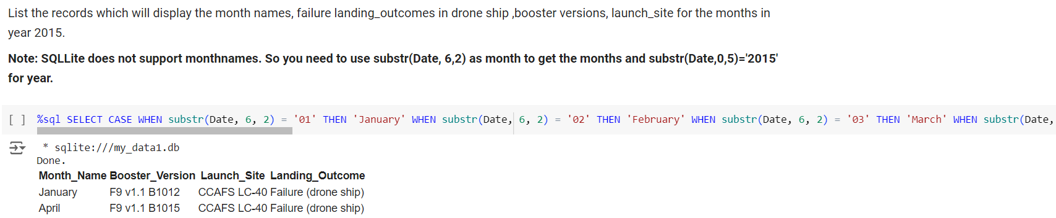
2015 Launch Records
The query retrieves records of failed drone ship landings from the year 2015 and then converts the month portion of the date into the corresponding month name (e.g., "01" to "January"). It then selects the month, booster version, launch site, and landing outcome for each failed landing.

Slide 33
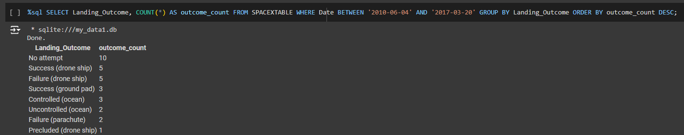
Rank Landing Outcomes Between 2010-06-04 and 2017-03-20
I filter records with WHERE Date BETWEEN '2010-06-04' AND '2017-03-20' to exclusively pull records that fall within that date range. GROUP BY Landing_Outcome groups these records by each unique landing outcome, and COUNT(*) AS outcome_count enumerates occurrences of each. ORDER BY outcome_count DESC sorts the results in descending order.

Slide 34

Section 3

Slide 35
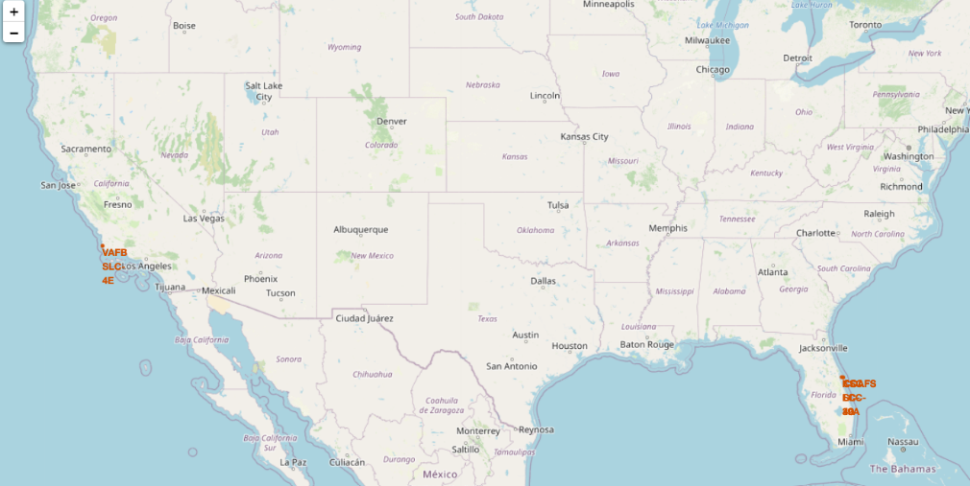
Launch Site locations
The launch sites are in Brevard County, FL and Santa Barbara County, CA – both year-round warm weather locations on the coast with climatic conditions that are consistently suitable for launches

Slide 36

Launch Outcomes
Red = failed launch. Green = successful launch.

Slide 37
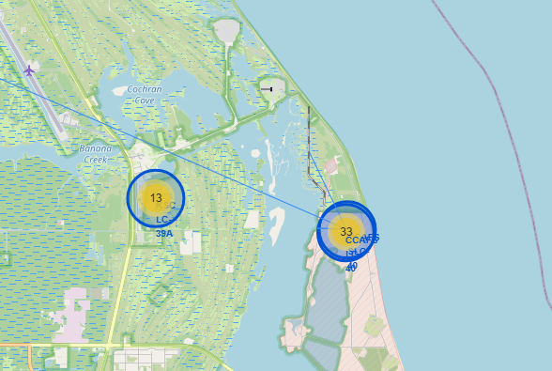
Launch Site Proximities

Slide 38

Section 4

Slide 39
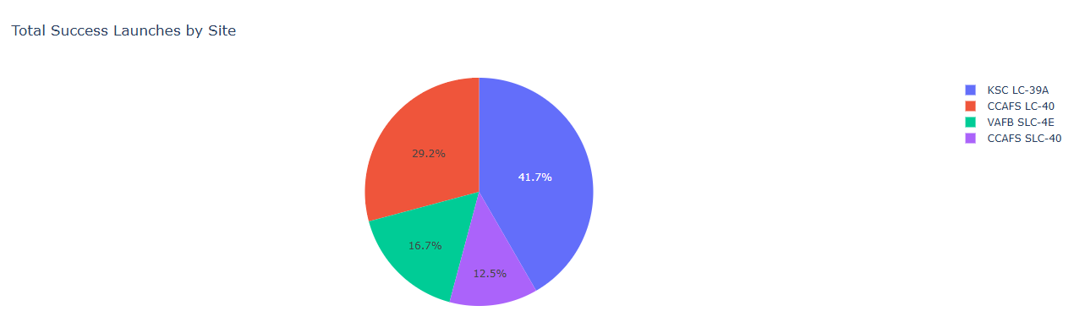
Launch Success by Site
Replace <Dashboard screenshot 1> title with an appropriate title
Show the screenshot of launch success count for all sites, in a piechart
Explain the important elements and findings on the screenshot

Slide 40
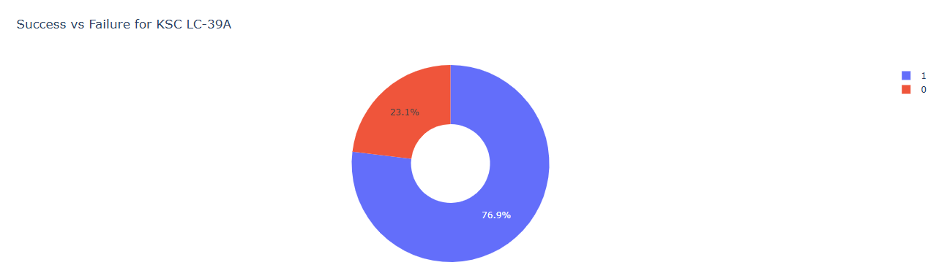
KSC success/failure

Slide 41
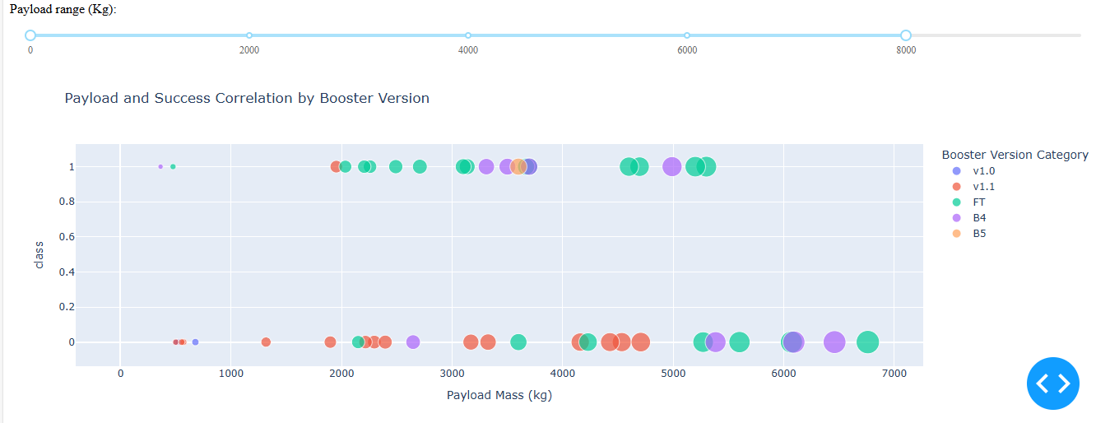
Payload and Launch Outcome
Replace <Dashboard screenshot 3> title with an appropriate title
Show screenshots of Payload vs. Launch Outcome scatter plot for all sites, with different payload selected in the range slider
Explain the important elements and findings on the screenshot, such as which payload range or booster version have the largest success rate, etc.

Slide 42

Section 5

Slide 43
Classification Accuracy
Visualize the built model accuracy for all built classification models, in a bar chart
Find which model has the highest classification accuracy

Slide 44
Confusion Matrix
Show the confusion matrix of the best performing model with an explanation

Slide 45
Conclusions
Point 1
Point 2
Point 3
Point 4
…

Slide 46
Appendix
Include any relevant assets like Python code snippets, SQL queries, charts, Notebook outputs, or data sets that you may have created during this project

Slide 47


